Slide 1
PROJECT maCHA Chama Management System
Presented by:
Odao Moureen – Project Manager & Backend Developer
Ann Wanja Muriithi – Database Management & Documentation
Nancy Mokaya – Database Management & Documentation
Eugene Owuor – Frontend Development
Developed using:
Python
HTML
CSS

Slide 2
WHAT IS A CHAMA?
Many Chamas still rely on:
Paper records Manual calculations Physical attendance books Slow report generation Loss of records Errors in contribution tracking
Therefore, there is a need for a computerized Chama Management System.
A Chama is a community savings and investment group where members contribute money regularly for savings, loans, investments, and financial support.

Slide 3
PROBLEM STATEMENT
Existing Chama management methods present several challenges:
Manual recording of member contributions
Poor tracking of contribution history
Delayed communication between members
Difficulty monitoring beneficiary rotation
Lack of financial transparency
The project addresses these challenges by providing a centralized web-based management system.

Slide 4
PROJECT OBJECTIVES
The main objective of this project is To design and implement a web-based Chama Merry-Go-Round Management System that automates the management of Chama activities.
SPECIFIC OBJECTIVES
Automate member registration
Digitally manage Chama groups
Record and monitor member contributions
Manage beneficiary payouts Generate reports

Slide 5
SYSTEM USERS
Administrator: Manage user accounts , Monitor the system ,Generate reports
Chairperson: Create Chama groups ,Approve members ,Schedule payouts
Member: Register and log in ,Join groups ,Make contributions ,View contribution history ,Receive notifications

Slide 6
SYSTEM REQUIREMENTS
Functional requirements
The implemented system provides:
User registration
User login
Dashboard
Group management
Member management
Contribution management
Payout management
Notifications
Reports
User settings
These functions automate the daily operations of a Chama.

Slide 7
TECHNOLOGY STACK
Technologies used
Frontend
HTML5
CSS3
JavaScript
Backend
Python
Flask Framework
Database
SQLite
Development Tools
Git & GitHub
Visual Studio Code

Slide 8
SYSTEM ARCHITECTURE
The application follows a three tier architecture
Presentation Layer
HTML
CSS
JavaScript
↓
Application Layer
Flask
Business Logic
Authentication
Validation
↓
Database Layer
SQLite Database
This architecture separates the user interface, application logic and data storage, making the system easier to maintain and expand.

Slide 9
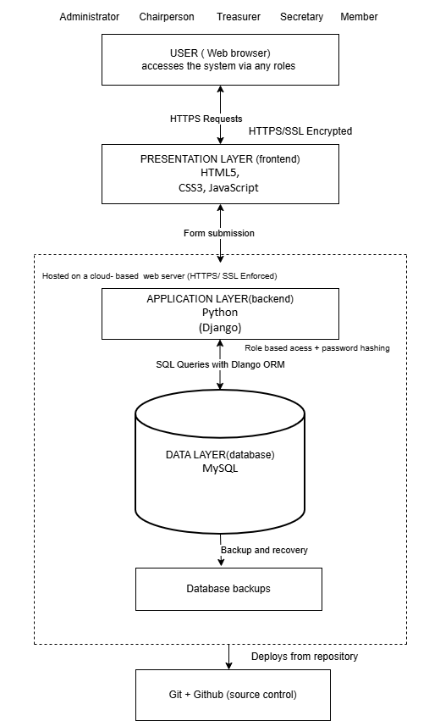

Slide 10
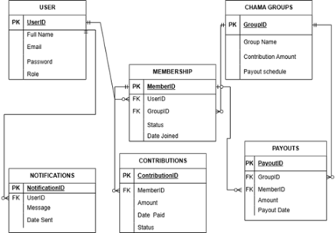
DATABASE DESIGN
The system stores data in SQLite.
Main database tables include:
Users ,Members ,Groups ,Contributions ,Payouts ,Notifications ,Settings
Relationships between these entities are represented using the Entity Relationship Diagram (ERD).

Slide 11
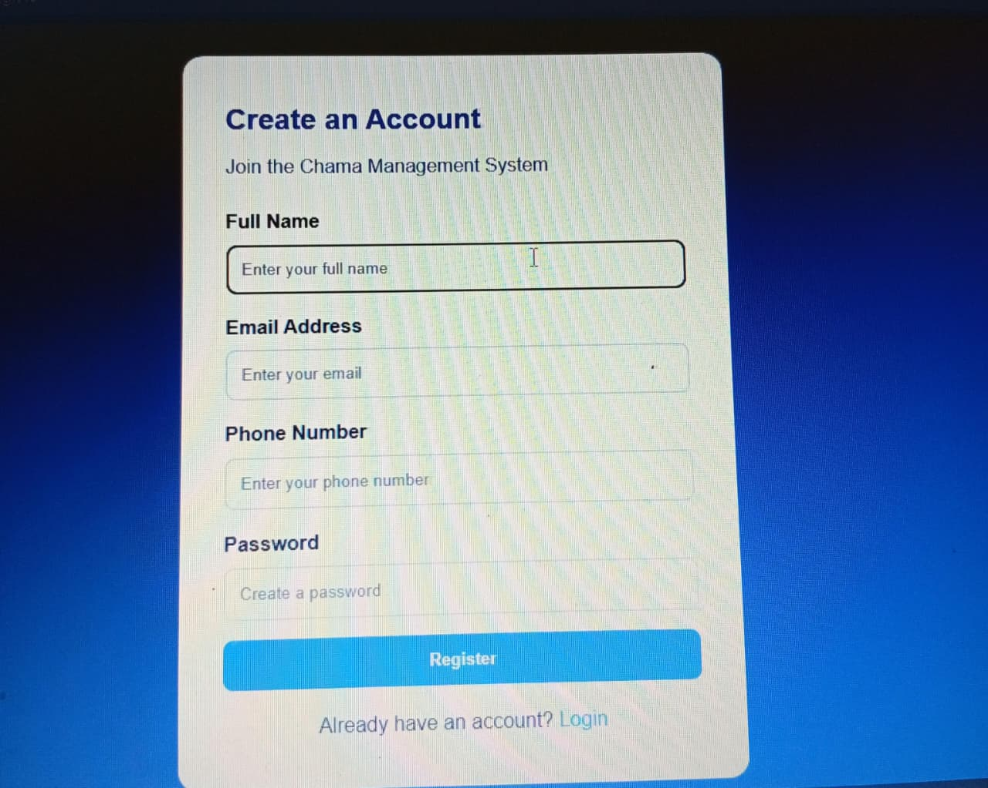
USER AUTHENTICATION
User Registration and Login
The implemented authentication module allows users to:
Create an account
Enter personal information
Log into the system
Validate user credentials
Store encrypted passwords
Access the dashboard after successful login
This functionality was implemented using Flask routes and SQLite.

Slide 12
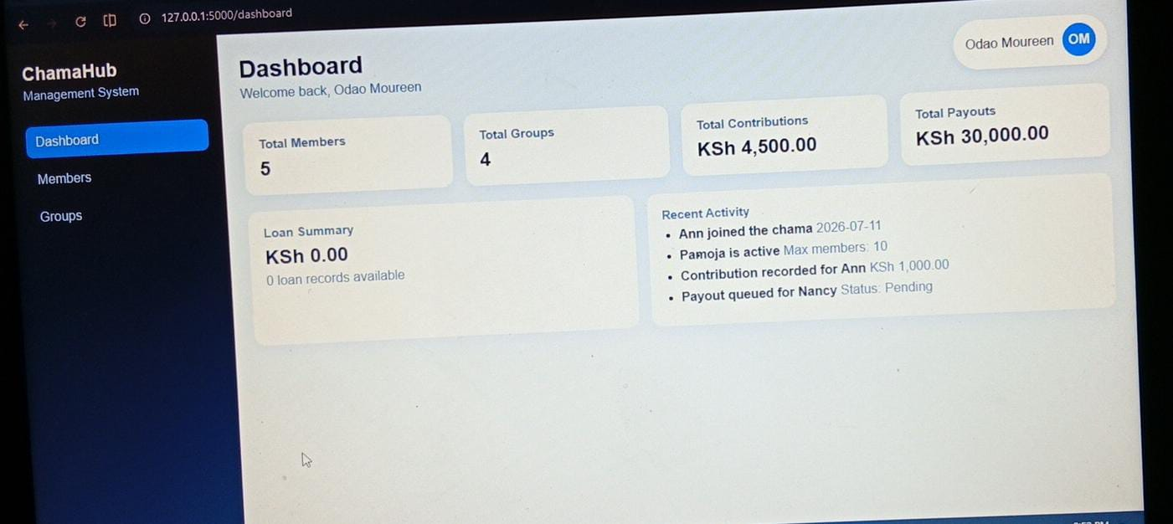
DASHBOARD
The dashboard provides a summary of the system by displaying:
Total members
Total groups
Total contributions
Total payouts
Contribution totals
Pending payouts
Recent activities
This enables administrators to monitor Chama activities from a single interface.

Slide 13
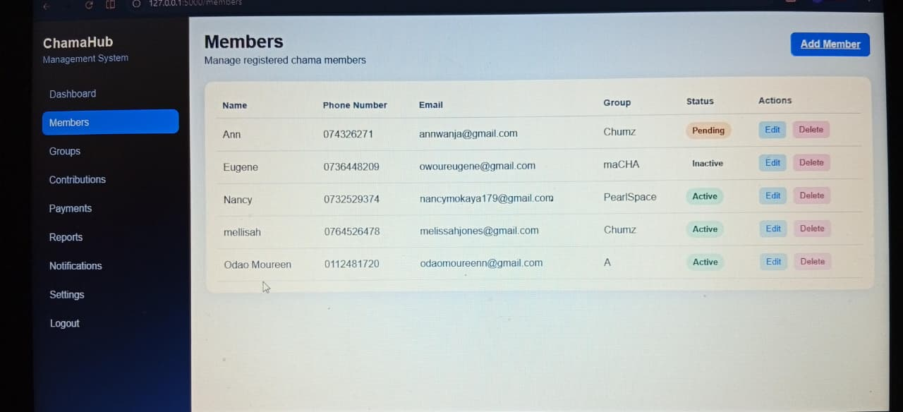
MEMBER AND GROUP MANAGEMENT
The system enables administrators to:
Add new members
View member information
Create Chama groups
View available groups
Organize members into groups
This improves organization and simplifies management of Chama records.

Slide 14
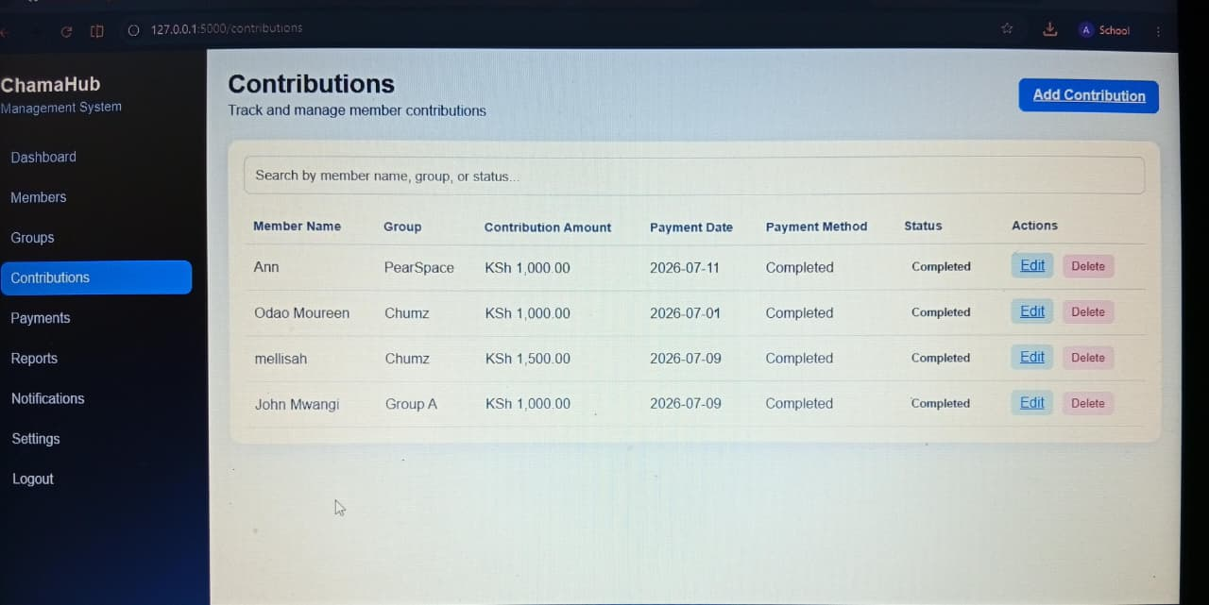
CONTRIBUTION MANAGEMENT
The contribution module allows administrators to:
Add new contributions
View contribution records
Edit contribution information
Track contribution history
The system stores every contribution in the SQLite database, making financial records easier to retrieve and manage.

Slide 15
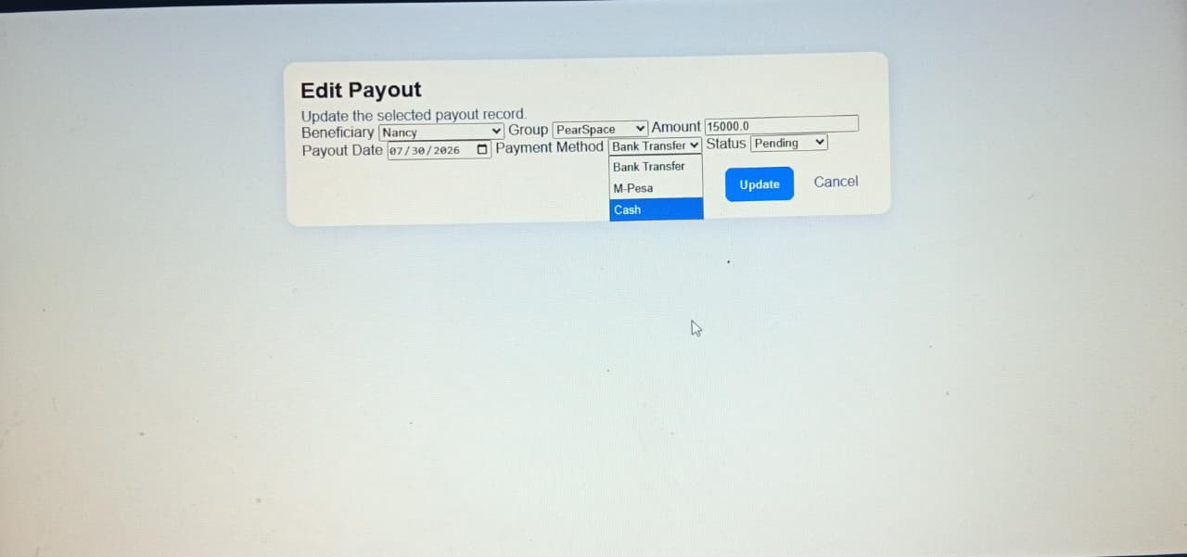
PAYOUT MANAGEMENT
The payout module allows administrators to:
Add payouts
Update payout information
Track beneficiary payments
View payout history
Monitor payout status
This module supports the Merry-Go-Round rotation process.

Slide 16
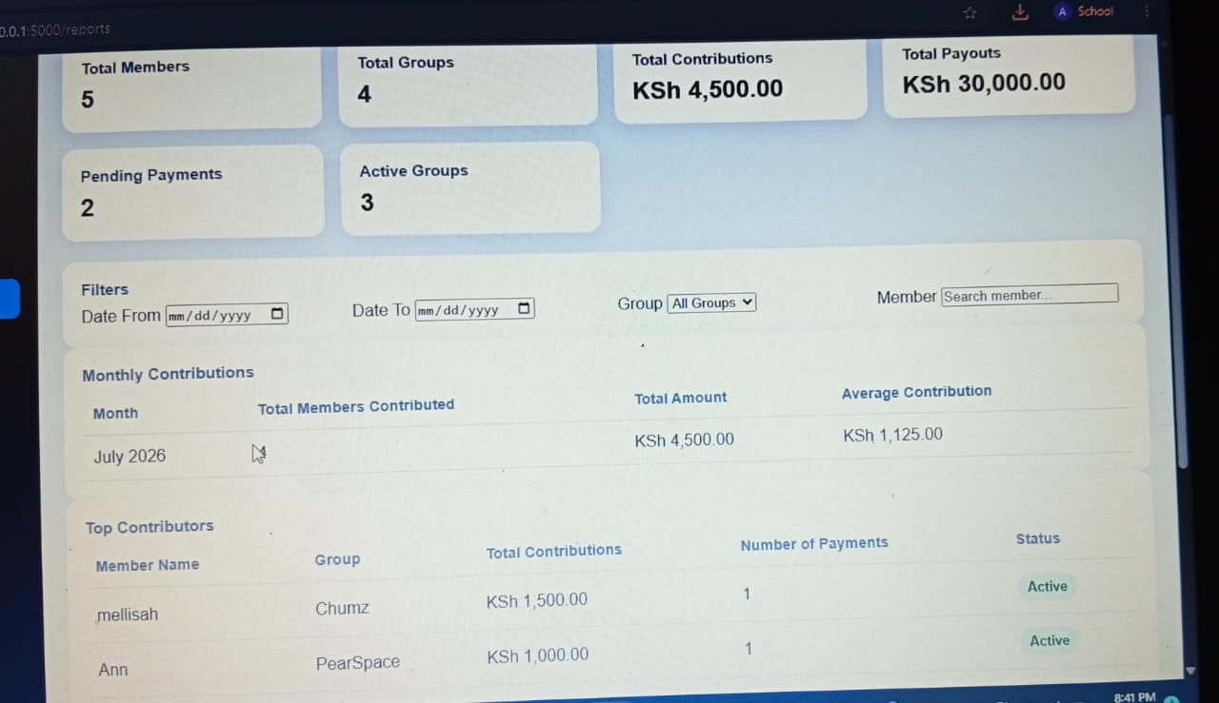
REPORTS AND NOTIFICATIONS
The system provides:
Reports
Contribution reports
Financial summaries
Member activity information
Notifications
View notifications
Send announcements
Improve communication between administrators and members
These modules assist in monitoring Chama activities efficiently.

Slide 17
SYSTEM IMPLEMENTATION
The developed application was implemented using:
Flask for server-side processing
SQLite for database management
HTML, CSS and JavaScript for the user interface
SQLAlchemy for database interaction
GitHub for version control
The application successfully connects the frontend, backend and database to provide a complete web-based Chama management solution.

Slide 18
CHALLENGES ENCOUNTERED
During development, the team experienced several challenges:
Learning Flask framework
Designing relationships between database tables
Integrating frontend with backend
Managing version control using GitHub
Testing CRUD operations
Working within the one-month project timeline
These challenges were addressed through teamwork, testing and continuous debugging.

Slide 19
FUTURE IMPROVEMENTS
Future versions of the system will include:
M-Pesa Daraja API integration
SMS notifications
Email automation
AI-powered chatbot
Mobile application
Loan management
Offline support
Dashboard analytics

Slide 20
CONCLUSION
The Web-Based Chama Merry-Go-Round Management System successfully automates the management of Chama activities.
The implemented system enables:
User registration and authentication
Member management
Group management
Contribution tracking
Payout management
Report generation
Notifications
Overall, the project reduces manual record keeping, improves transparency, enhances accountability and provides an efficient digital platform for managing Chama operations.

Slide 21


